Slide 1

Introduction to NLA
Bill Herz and Colleen McNickle

Slide 2

What is Lime?
  Lime is essential to life. It is derived from limestone, or calcium carbonate, and it is necessary for everyday life. Various forms of lime are used in environmental, metallurgical, construction, chemical/industrial applications, and more.
  To read more, please visit: https://www.lime.org/whyislimeimportant/

Slide 3
How is Lime made?
  The making of lime starts with extracting limestone from quarries or mines, which is followed by crushing, sorting, and grading. Limestone is then fed into a kiln and heated to temperatures above 1600 degrees F – a process known as calcination, which produces lime or “quicklime.” Lime can then be used as is or hydrated for extra versatility. From rock to essential mineral!
  To read more, please visit: https://www.lime.org/how-is-lime-made/

Slide 4
What are the Uses of Lime?
Lime is the versatile mineral. Various forms of lime are used in environmental, metallurgical, construction, chemical/industrial applications, and more. The fastest-growing use of lime is in environmental applications, where lime is used to comply with air, drinking water, wastewater, and solid waste regulations.
However, the largest single use of lime remains in steel manufacturing, where it is used to remove impurities.
To learn more, please visit: https://www.lime.org/uses-of-lime/

Slide 5
What does NLA do?
  NLA’s mission is to represent, protect, and promote the nation’s lime industry. NLA accomplishes this by projecting a unified voice responding and working to ensure that legislation, regulations, and standards affecting the industry are reasonable, practical, and mutually beneficial to the industry and society.
  To read more, please visit: https://www.lime.org/about-us/mission/

Slide 6
What’s our focus?
  Advocacy
  Compliance Assistance
  Innovations for the Lime Industry
  Promotion and Research
  To read more, please visit: https://www.lime.org/about-us/overview/

Slide 7
Members
Our members are lime-producing companies across the country. To browse the company closest to you, visit: https://www.lime.org/find-a-lime-plant/
Carmeuse
Cheney Lime
Graymont
Greer Lime Company
Lhoist
Martin Marietta
MLC
Pete Lien
RHI Magnesita
U.S. Lime

Slide 8
Associate Members
Our associate members are companies that provide all types of support services for the lime production industry.
To see a complete list of our Associate Members, please click here: https://www.lime.org/suppliers-to-the-lime-companies/

Slide 9
Committees
We have a wide range of committees employing our members’ lime professionals. They are as follows:
Board of Directors
Communications
Environmental
EPD, LCA, PCA
GHG Reporting
Health and Safety
RTR Subcommittee
Sustainability

Slide 10






NLA Staff
William C. Herz, MPH
Executive Director
Hunter L. Prillaman
Dir. of Govt. Affairs/ Senior Counsel
Jonathan De’Ath
Dir. of Environmental Affairs
Bradford Frisby
General Counsel
Deborah J. Maffett
Dir. of Finance, Admin, & Events
Colleen McNickle, M.S.
Communications Manager

Slide 11




Find us on Socials
Please visit and follow NLA’s pages by clicking on the links below:
NLA on Instagram
NLA on X
NLA on LinkedIn
NLA on Facebook

Slide 12
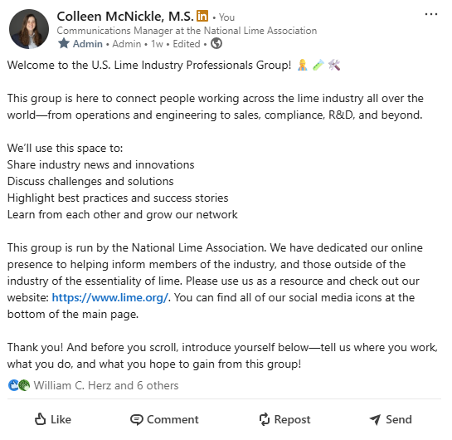
Lime Professionals:
Join us in our newly formed Global Lime Group on LinkedIn here: https://www.linkedin.com/groups/13320019/

Slide 13
Thank You
For more information, please visit www.lime.org.

