Slide 1
Program to Enhance Data Quality of Particulate Matter Emissions Testing
EPA Method 5
Laura Kinner
EMI

Slide 2
Phased Approach
Phase I
Facility Preparations
Phase II
Tester Preparations
Phase III
Emissions Testing
Phase IV
Data Evaluation
Notes:
Phase I and II concurrent

Slide 3
Phase I: Facility Prep
Creation of team – plant manager, engineers, environmental, and kiln operators
Establishing “representative test conditions”
Evaluate previous testing data
Ensure COM operating properly – 3-6 months before test
Evaluate COM data graphically
Look for trends
High or shifting baselines
Bandwidth of data
Notes:
Important to establish lines of internal and external communication to determine if issues arise that would affect data quality
Peeler’s presentation details effective use of COM and data interpretation.

Slide 4
Phase II: Tester Prep
Coordinate with Testers
Additional QA
Flowrate
PM Collection
PM Sample Recovery
Blanks
Expectations regarding set-up day
Timing
Preliminary Results
Notes:
Important to coordinate with testers and establish a point of contact. This establishes accountability.
Preliminary results are needed on set-up day to ensure everything is as expected for normal operations. This also gives testers a trial run in the event they have equipment problems that need to be resolved.

Slide 5
Phase II – Additional QA
Flow rate
0.84 cP (default) vs wind tunnel-calibrated pitot tube
Pitot positioning
More points than specified in Method 1
Settling of manometer oil
PM Testing
No Stainless Steel
Glass or Quartz only, unless sure chance of breakage
Brush probes and nozzle prior to test start
Probe and Filter Box capable of maintaining heat
Notes:
Flow rate is the largest factor in the calculation of lb/hr. Type S pitot tube measurements can have 5% error (or more). Calibrated pitot tubes will generally have a cP lower that 0.84 (the allowed default value).

Slide 6
Phase II – Additional QA PM Recovery
High quality solvents & rinse bottles
Do not store solvents in bottles overnight
Clean environment
Dusty parking lot or on-stack recovery may result in high bias.
Probes are generally brushed and recovered on-stack.
Quality of probe rinse brush & extension
Much of PM captured may be captured in probe & front half filter
Use new or pre-cleaned brush and care with probe brush extension.
Technique dependent

Slide 7
Case History: Flawed PM Probe Wash
PM recovered in probe rinse from first run (18 mg) double the average of second (10 mg) and third (7 mg) runs
Multiple causes:
Dusty environment
Probe and nozzle not rinsed immediately before test
Question test results if steep downward trend in PM

Slide 8
Phase III: Emissions Testing
Coordinate arrival schedule
Establish points of contact and get cell phone info etc..
Give testers plant radio
Arrange for preliminary data collection
Volumetric flow rate
CO2, O2 and Moisture
Compare to past results

Slide 9
Emissions Testing cont’d
Assign knowledgeable person to observe from facility
Observe leak checks
Observe proper temperatures for probe & filter
Observe sample recovery
Manage issues as they arise
Assign knowledgeable person to escort agency observer
Notes:
If a test is conducted and there is a process upset, the test can not be stopped. An additional test run should be conducted in the event the “upset” condition results in non-representative data.

Slide 10
Why is Temperature Important?

Slide 11
EPA Method 5
Filterable Particulate Matter
248 ⁰ F (+/-25⁰F)
Gases and
PM <0.3 µ
Method 5 Probe
248 ⁰ F (+/-25⁰F)
Sample is extracted
“isokinetically”
Filterable Particulate Matter
Out of Stack Filter at ~ 250F

Slide 12
M5 Probe and Filter
“Too Hot”
Gases and
PM <0.3 µ
Method 5 Probe
> 270 ⁰ F (+/-25⁰F)
Sample is extracted
“isokinetically”
Filterable Particulate Matter
Out of Stack Filter at > 270F

Slide 13
M5 Probe and Filter
“Too Cold”
Gases and
PM <0.3 µ
Method 5 Probe
< 250 ⁰ F (+/-25⁰F)
Sample is extracted
“isokinetically”
Filterable Particulate Matter
Out of Stack Filter at < 250F
Notes:
Potential to collect more PM in probe and on filter

Slide 14
Look at PM Filter and Probe Wash

Slide 15
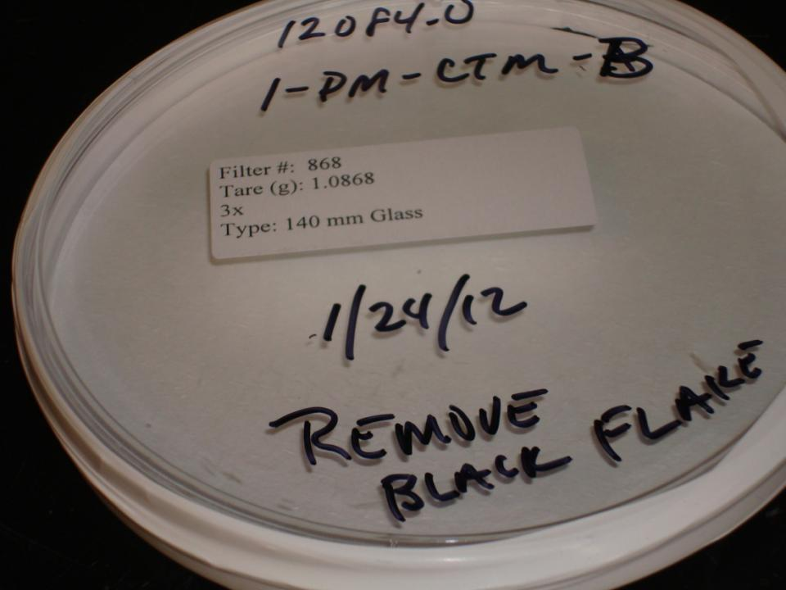
Notes:
Back filter - notation is to remove black flake (obvious) not from stack
Is there other dust or particles on the filter (i.e., rust) that is not part of the stack dust?

Slide 16
Phase IV: Data & Report Evaluation
Most important is to read report to determine if results are in compliance.
Do not let testers submit directly to agency without review!
Look at results summary and ensure it matches data in the appendices.
Conduct a sample results calculations check for one of the runs.

Slide 17
Phase IV: Data & Report Evaluation
Ensure testers have not misstated any operating condition.
Ensure there are no “cut and paste” errors. (i.e.,, naming the wrong plant)
Ensure process data have been included in the appendices of the report.
Ensure data make sense with respect to past emissions test reports.

